Slide 1

Chapter 4
Socialization
SOC 2020
Sixth Edition

Slide 2
What’s to Come?
The Role of Socialization.
The Self and Socialization.
Agents of Socialization.
Socialization throughout the Life Course.
Aging and Society.
Perspectives on Aging.

Slide 3
As You Read
How do we become ourselves?
Who shapes our socialization?
How does our development change over time?

Slide 4
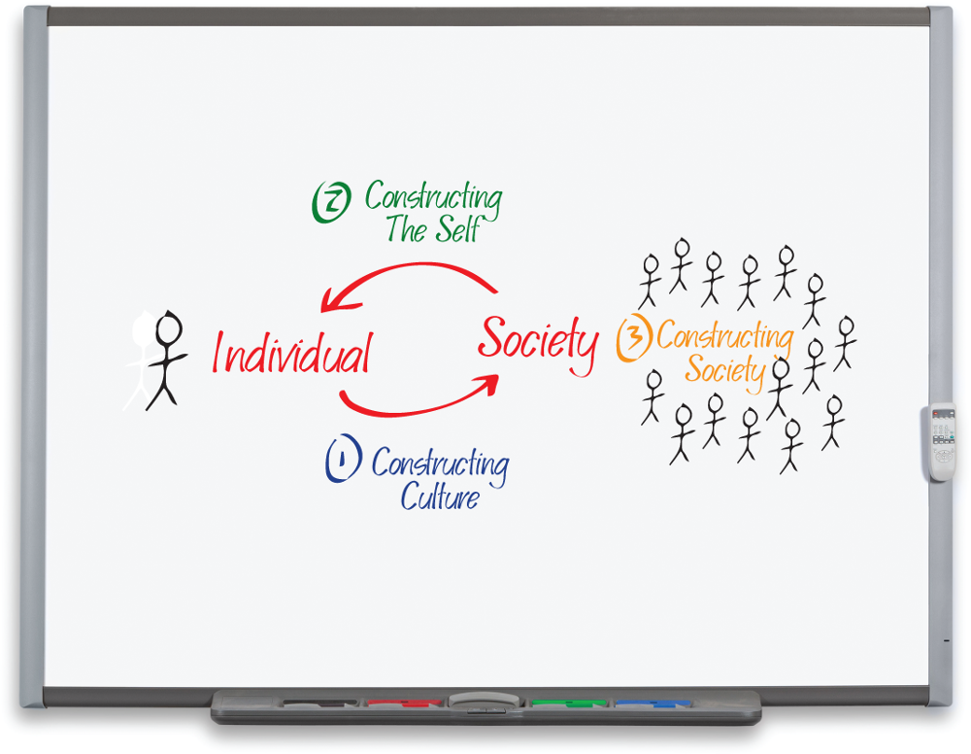
The Role of Socialization
In the first stage of “World Construction,” we construct a culture.
In the second stage, we become products of the world we create.
We become ourselves as a consequence of what we learn from others.
Access the text alternative for slide images.
Photo: RTimages/Alamy Stock Photo

Slide 5
Internalizing Culture
Socialization: the lifelong process through which people learn the attitudes, values, and behaviors appropriate for members of a particular culture.
Language is perhaps the most basic element of culture we need to learn.

Slide 6
The Impact of Isolation
Missing out on early socialization can have a devastating impact.
Extreme Childhood Isolation.
The cases of Genie and Danielle demonstrate the importance of early socialization experiences for children.
Primate Studies.
Psychologist Harry Harlow showed isolation had a damaging effect on rhesus monkeys.
Humans lack the complex instincts necessary for survival and rely on culture and socialization instead.

Slide 7

Cases of Children Raised in Extreme Isolation
Access the text alternative for slide images.
Sources: Keith 2008; Newton 2002; www.feralchildren.com. Photos: Child: Denis Gukov/AFP/Getty Images; Book: Preto Perola/Shutterstock

Slide 8
The Self and Socialization
As individuals we choose what to think and how to act—but we do so within the confines of the cultural resources to which we have access.

Slide 9
Sociological Approaches to the Self 1
Self: our sense of who we are, distinct from others, and shaped by our unique social interactions.
Not a static entity.
It continues to develop and change throughout our lives.

Slide 10
Sociological Approaches to the Self 2
Cooley: The Looking-Glass Self.
Charles Horton Cooley’s looking-glass self: a theory that we become who we are based on how we think others see us.
We imagine how others see us—relatives, friends, even strangers on the street.
We imagine how others evaluate what we think they see—as intelligent, attractive, shy, or strange.
We define our self as a result of these impressions.

Slide 11
Sociological Approaches to the Self 3
Mead: Stages of the Self.
According to George Herbert Mead (1863 to 1931) the I is the acting self that exists in relation to the Me.
The Me is the socialized self that plans actions and judges performances based on the standards we have learned from others.
Significant other: an individual who is most important in the development of the self, such as a parent, friend, or teacher.

Slide 12
Sociological Approaches to the Self 4
Mead: Stages of the Self, continued.
Preparatory Stage.
Children imitate the people around them, especially family.
Symbol: a gesture, object, or word that forms the basis of human communication.
Play Stage.
Children pretend to be other people.
Role taking: the process of mentally assuming the perspective of another and responding from that imagined viewpoint.
Game Stage.
Children grasp their own social positions and those of others.

Slide 13
Sociological Approaches to the Self 5
Thomas: Perception and Action.
It is perception, more than reality itself, that shapes how we act.
If perception shapes action, position shapes perception.
What we learn through socialization depends on the positions we occupy relative to others.

Slide 14
Sociological Approaches to the Self 6
Goffman: Presentation of the Self.
Dramaturgical approach: a view of social interaction in which people are seen as actors on a stage trying to put on a successful performance.
Goffman draws our attention to various aspects of performance: front stage, team, scripts; backstage, props; and audience.
Impression management: the altering of the presentation of the self in order to create distinctive appearances and satisfy particular audiences.
Face-work: altering our presentation of self in order to maintain a proper image and avoid public embarrassment.

Slide 15
Us versus Them 1
Ethnocentrism assumes that our own culture represents what’s normal and is superior to others.
It is a natural response, but it frequently has a negative effect on how we view other people.
Group membership leads us to identify with others in the group, privilege each other, and seek to deny benefits to those outside the group.
Social psychologist Henri Tajfel identified three core elements in creating us versus them mentalities:
Social categorization.
Social identification.
Social comparison.

Slide 16
Us versus Them 2
Prejudice: the preconceived and unjustified judgment of individuals, whether positive or negative, based on their membership in a particular group.
Implicit bias: the automatic and unconscious association of value, whether positive or negative, with particular groups, sub-groups, or characteristics of people.

Slide 17
Agents of Socialization
The various contexts within which individuals and groups shape our identity are agents of socialization.
Family.
School.
Peer groups.
Mass media.
Workplace.
Religion.
State.

Slide 18
Family
Family is the most important agent of socialization.
Children play an active role.
Cross-Cultural Variation.
How children are socialized within families varies significantly around the world.
The Influence of Race and Gender.
In the United States, social development within families includes exposure to cultural assumptions regarding gender and race.
Gender roles: the normative expectations regarding proper behavior, attitudes, and activities associated with maleness and femaleness.

Slide 19
School and Peer Groups
Schools teach children the values and customs of the larger society.
They can also reinforce existing inequality through the ways students are socialized.
As children grow older, peers become increasingly important in shaping how they think and act.
Children get messages about where they fit and how they should behave.
Popularity tends to reinforce gender stereotypes.
High school peer groups tend to misperceive members of other groups.

Slide 20
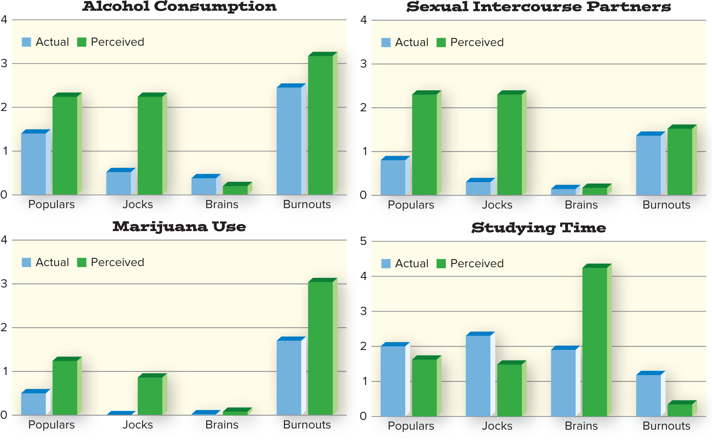
High School Behavior: Perception versus Reality
Note: Actual represents the average of self-reported practices for students within that peer group; Perceived represents responses from students outside the group. Source: Helms et al. 2014.
Access the text alternative for slide images.

Slide 21
Mass Media
Media innovations—print, recordings, cinema, radio, television, the Internet, mobile phones—have become important agents of socialization.
New technologies have changed how people worldwide interact with family, friends, and strangers.
Like other agents of socialization, media change how we think and act.
Exposure to new cultural beliefs and practices may lead to greater acceptance but can also challenge the culture we hold dear.

Slide 22
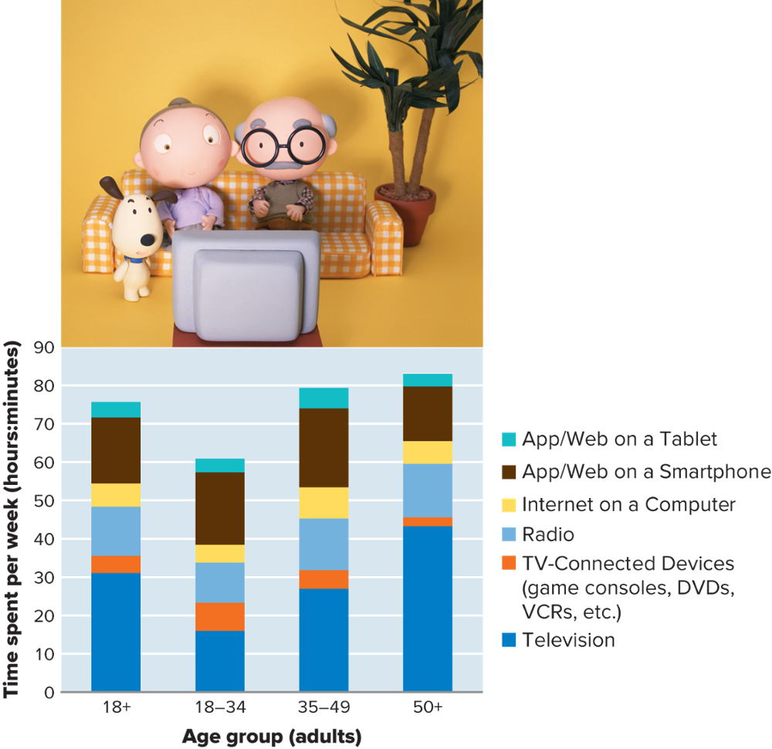
Average Time Spent Using Media per Week by Age Group
Access the text alternative for slide images.
Source: Nielsen 2017. Photo: Datacraft Co Ltd/Getty Images

Slide 23
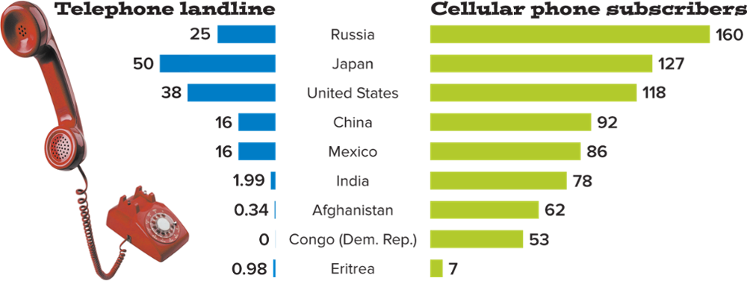
Telephones and Cell Phones by Country (rates per 100 people)
Access the text alternative for slide images.
Source: International Telecommunications Union 2017. Photo: EyeWire/Getty Images

Slide 24
The Workplace
Learning to behave appropriately within an occupation is a fundamental aspect of human socialization.
Employers and coworkers want to be confident that you know what to do and when to do it.
Socialization in the workplace changes when it involves a more permanent shift to full-time employment.
Today the typical person holds many jobs over a lifetime, so we must be open to ongoing occupational socialization.

Slide 25
Religion and the State
In the United States, the family’s protective function has been steadily transferred to outside agencies.
Government and organized religion both act to provide markers representing significant life course transitions.
Baptism, bismillah, bar/bat mitzvah.
Ages at which a person may drive a car, drink alcohol, vote in elections, etc.

Slide 26
Socialization throughout the Life Course
Rite of passage: a ritual marking the symbolic transition from one social position to another, dramatizing and validating changes in a person’s status.
For example, the quinceañera ceremony.

Slide 27
The Life Course
Life course approach: a research orientation in which sociologists and other social scientists look closely at social factors that influence people throughout their lives, from birth to death.
Milestones vary from one society, and even one generation, to the next.
In the United States, unlike some other societies, no clear dividing line exists between adolescence and adulthood.

Slide 28
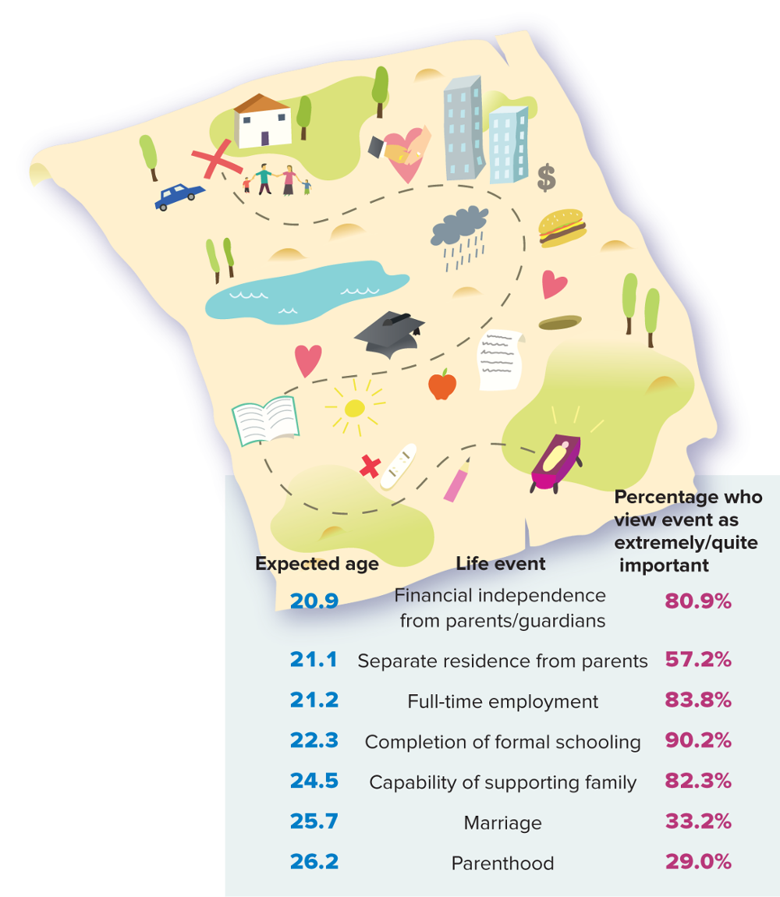
Milestones in the Transition to Adulthood
Access the text alternative for slide images.
Source: Smith 2004.

Slide 29
Anticipatory Socialization and Resocialization 1
Anticipatory socialization: processes of socialization in which a person “rehearsesˮ for future positions, occupations, and social relationships.
Resocialization: the process of discarding former behavior patterns and accepting new ones as part of a transition in one’s life.
Resocialization is particularly effective when it occurs in a total institution.
Prison, the military, a mental hospital, a convent.

Slide 30
Anticipatory Socialization and Resocialization 2
Total institution: an institution that regulates all aspects of a person’s life under a single authority.
Erving Goffman identified several common traits of total institutions:
All aspects of life are conducted in the same place under a single authority.
Activities are conducted in the company of others in the same circumstances.
The authorities devise rules and schedule activities.
All aspects of life are designed to fulfill the purpose of the organization.

Slide 31
Anticipatory Socialization and Resocialization 3
People often lose their identity within total institutions.
Degradation ceremony: an aspect of the socialization process within some total institutions, in which people are subjected to humiliating rituals.

Slide 32
Role Transitions during the Life Course
Midlife crisis: a stressful period of self-evaluation that begins at about age 40.
Sandwich generation: the generation of adults who simultaneously try to meet the competing needs of their parents and their children.
Caring for aging parents falls disproportionately on women.

Slide 33
5 Movies on Socialization
Eighth Grade
Being yourself can be hard.
Welcome to Marwen
A man retreats from reality after a violent assault.
The Jungle Book
The live-action remake tells the fictional story of a boy raised by animals.
Don’t Think Twice
Friends in an improve group learn to adjust when one of them makes it big.
Three Identical Strangers
Identical triplets who never knew each other existed learn a surprising secret about why.

Slide 34
Aging and Society
Life expectancy has risen significantly both in the United States and around the world.
Babies born in the United States in 2016 can anticipate living to 76.1 if they’re boys and 81.1 if they’re girls.
How societies deal with their elderly population varies significantly across cultures
All societies have some system of age stratification that associates certain social roles with distinct periods in life.

Slide 35
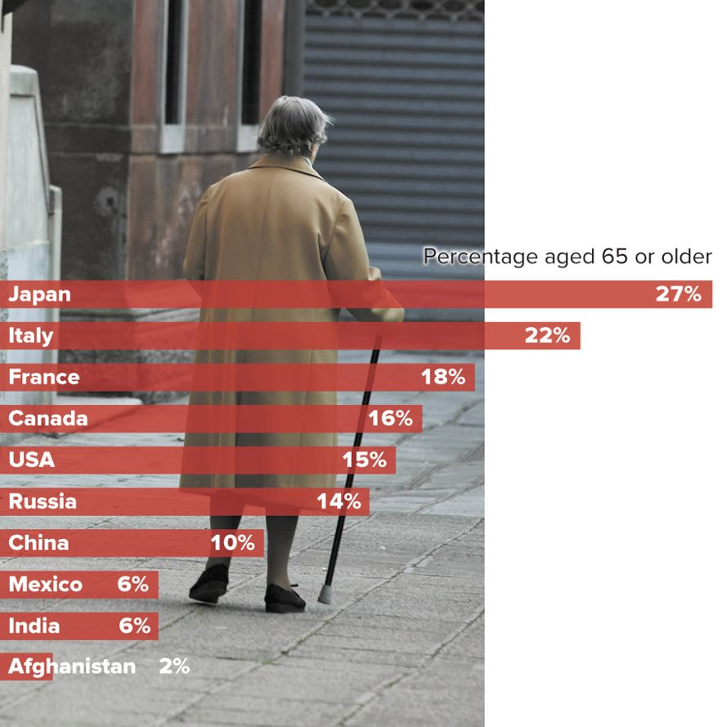
Aging around the World
Access the text alternative for slide images.
Source: Population Reference Bureau 2016. Photo: Ingram Publishing/age fotostock

Slide 36
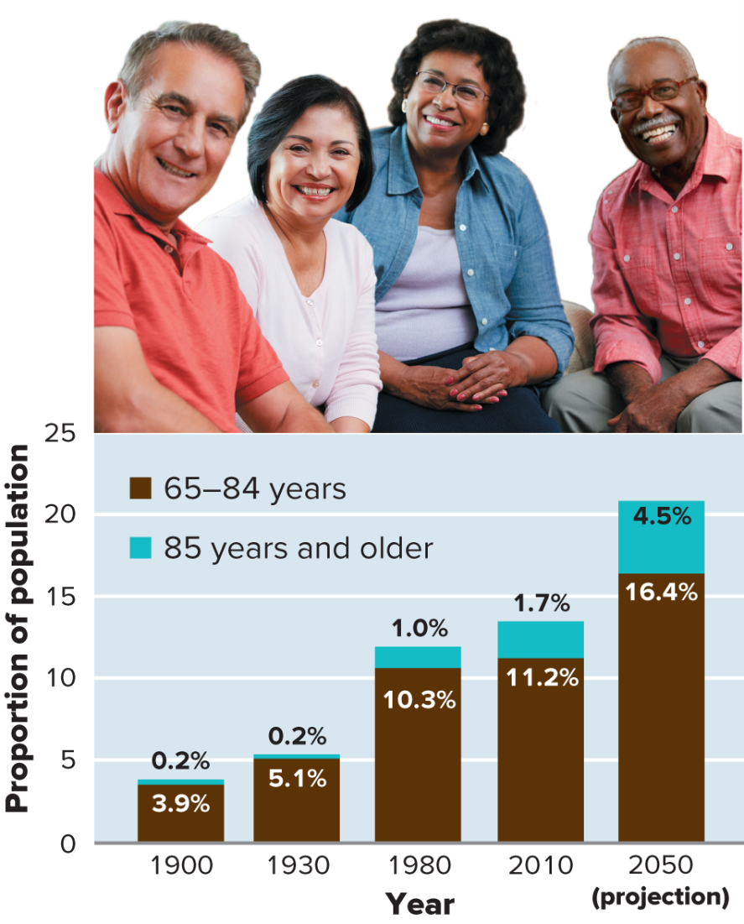
Actual and Projected Growth of the Elderly Population of the United States
Access the text alternative for slide images.
Sources: He et al. 2005:9; Ortman et al. 2014; Werner 2011. Photo: Monkey Business Images/Shutterstock

Slide 37
Adjusting to Retirement
Retirement is a rite of passage that typically marks a transition out of active participation in the full-time labor market.
Robert Atchley’s phases of retirement:
Preretirement.
Near phase
Honeymoon phase
Disenchantment phase.
Reorientation phase.
Stability phase.
Termination phase.

Slide 38
Perspectives on Aging
Gerontology: the study of the sociological and psychological aspects of aging and the problems of aging adults.
Relies heavily on sociological principles and theories.
Also draws on psychology, anthropology, physical education, counseling, and medicine.
Three perspectives on aging arise out of gerontological study:
Disengagement theory.
Activity theory
Age discrimination

Slide 39
Disengagement Theory
Disengagement theory: a theory of aging that suggests that society and the aging individual mutually sever many of their relationships.
The approach of death forces people to drop most of their social roles, which are then taken on by younger members of society.
Implicit in this theory is that society should help older people withdraw from their accustomed social roles.

Slide 40
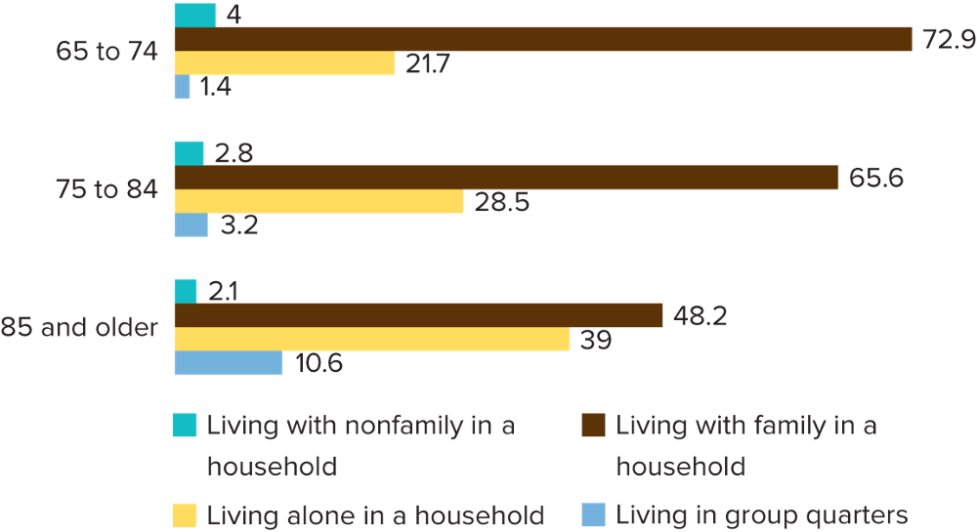
Living Arrangements by Age
Access the text alternative for slide images.
Source: Roberts et al. 2018.

Slide 41
Activity Theory
Activity theory: a theory of aging that suggests that those elderly people who remain active and socially involved will have an improved quality of life.
Often seen as the opposite of disengagement theory.
The improved health of older people has strengthened the arguments of activity theorists.
Accumulated medical evidence also points to the importance of remaining socially involved.

Slide 42
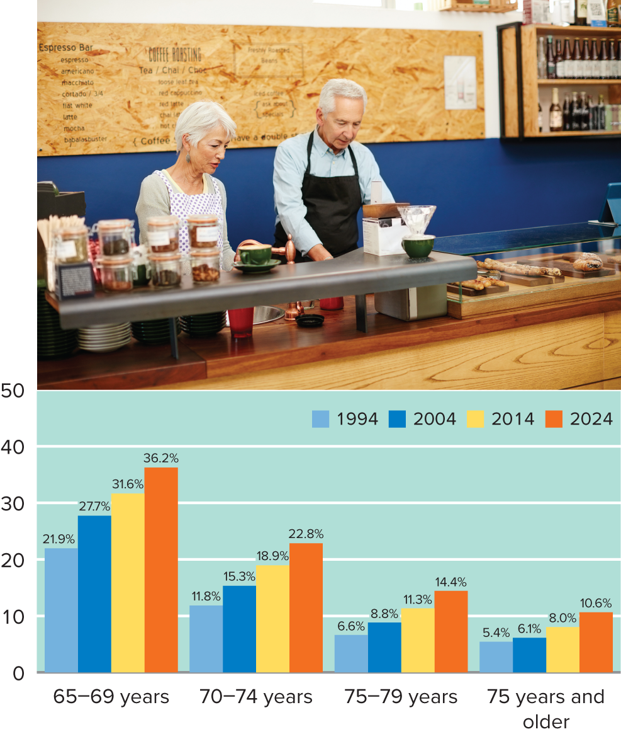
Rising Labor Force Participation Rates among Older Adults
Note: Data for 2024 are projections. Source: Toossi 2015:Table 3. Photo: laflor/Getty Images
Access the text alternative for slide images.

Slide 43
Ageism and Discrimination
Critics argue that neither disengagement nor activity theory address why social interaction among aging adults must change at all—and point to prejudice.
Ageism: prejudice and discrimination based on a person’s age.
As a whole, elderly people in the United States enjoy a higher standard of living than in the past.
Much of this improvement is due to more generous Social Security benefits.
Members of groups who face early income inequality continue to do so when they are older.

Slide 44
Death and Dying
Until recently, death was a taboo topic in the United States.
A “good death,” according to gerontologist Richard Kalish, involves facing certain issues.
Completing unfinished business.
Restoring harmony to social relationships.
Saying farewell.
Dealing with medical needs.
Making funeral plans and other arrangements.
Hospice care: treatment of terminally ill individuals with the goal of helping them die comfortably, without pain.

Slide 45
5 Movies on Aging
Up
A cranky old man and a young boy embark on an unusual adventure.
Our Souls at Night
Two elderly neighbors find comfort, companionship, and love.
45 Years
On the brink of their 45th wedding anniversary, a couple confronts the past.
Beginners
Love lessons learned from an elderly father.
The Bucket List
Two men confront death by ticking off items on their to-do list.

Slide 46
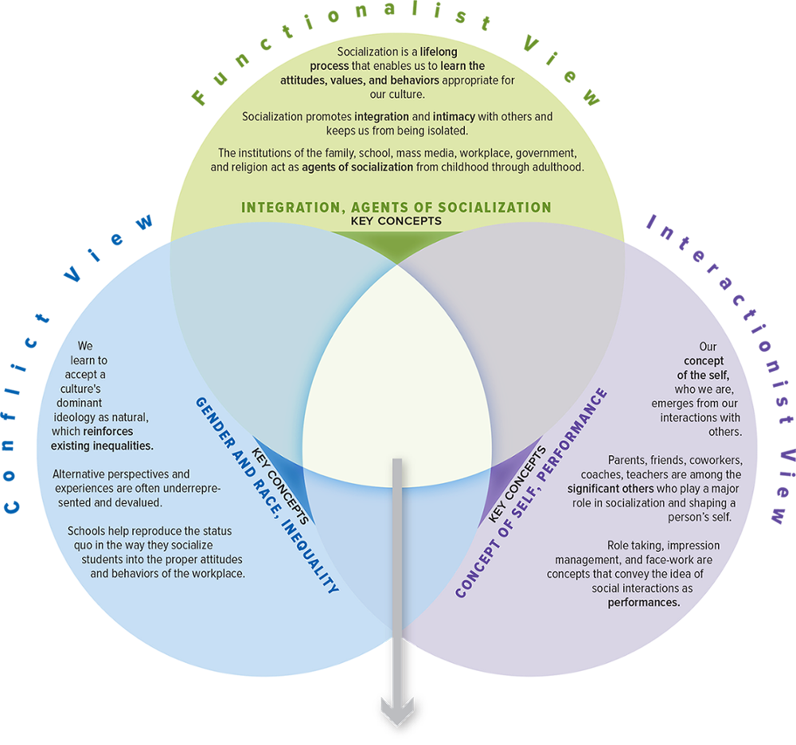
SOC VIEWS on Socialization
Access the text alternative for slide images.

Slide 47
Make the Connection
How would each perspective describe the impact that extreme isolation has on people?
How would each perspective explain the role socialization performs among children?
How would a functionalist look at anticipatory socialization? How might this view differ from a conflict approach?
Which agents of socialization have been most influential in your life? How does each perspective help shed light on those influences?

Slide 48
End of Main Content

Slide 49
Accessibility Content: Text Alternatives for Images

Slide 50
The Role of Socialization - Text Alternative
Return to parent-slide containing images.
Each individual contributes in constructing a society through their culture and the society in turn contributes in constructing an individual.
Return to parent-slide containing images.

Slide 51
Cases of Children Raised in Extreme Isolation - Text Alternative
Return to parent-slide containing images.
The cases follows: Shamdeo, the Sultanpur Wolf boy: He was about 4 years old when discovered playing with wolves, in 1974.
Memmie LeBlanc, the wild girl of Champagne: About 18 to 20 years old when found, she had learned language before having being abandoned.
John Ssebunya, the Uganda monkey boy: Found living with a pack of monkeys in 1991 at age 6, he now gives talks about his experience.
Ng Chhaidy of India: She disappeared in the jungle when she was 4 and, after persistent local rumors about a jungle girl, was found 38 years later in 2012.
Oxana Malaya, the Ukrainian dog girl: She was found living in the dog pen in her family’s back yard in 1991 at the age of 8.
Vanya Yudin, Russian bird boy: Found in February 2008, he was cared for by his mother but never spoken to and chirps like a bird.
The leopard boy of Dihungi: He was found among leopards at the age 5 in 1915 after having been in the wild three years.
Kamala and Amala, the wolf girls of Midnapore: These two girls were found living among wolves at about ages of 8 and 2 in 1920.
The Russian cow girl: This 5-year-old girl, found living with cows in 2012, communicated using mooning sounds.
Natasha Mikhailova the Siberian dog girl: This 5-year-old Russian girl, discovered in 2009, was raised like a pet in a room full of dogs and cats.
Return to parent-slide containing images.

Slide 52
High School Behavior: Perception versus Reality - Text Alternative
Return to parent-slide containing images.
First graph depicts alcohol consumption. The horizontal axis represents 4 different groups of students and the vertical axis ranges from 0 to 4. The graph infers the data in the following format: Group, actual, perceived. Populars, 1.5, 2.3; Jocks, 0.5, 2.3; Brains, 0.4, 0.2; and Burnouts, 2.5, 3.2.
Second graph depicts sexual intercourse partners. The horizontal axis represents 4 different groups of students and the vertical axis ranges from 0 to 4. The graph infers the data in the following format: Group, actual, perceived. Populars, 0.9, 2.4; Jocks, 0.4, 2.4; Brains, 0.2, 0.2; and Burnouts, 1.4, 1.5.
Third graph depicts Marijuana usage. The horizontal axis represents 4 different groups of students and the vertical axis ranges from 0 to 4. The graph infers the data in the following format: Group, actual, perceived. Populars, 0.5, 1.2; Jocks, 0, 0.9; Brains, 0, 0.1; and Burnouts, 1.7, 3.1.
Fourth graph depicts studying time. The horizontal axis represents 4 different groups of students and the vertical axis ranges from 0 to 5. The graph infers the data in the following format: Group, actual, perceived. Populars, 2.1, 1.6; Jocks, 2.3, 1.5; Brains, 2.0, 4.2; and Burnouts, 1.2, 0.3. All the values are approximated.
Return to parent-slide containing images.

Slide 53
Average Time Spent Using Media per Week by Age Group - Text Alternative
Return to parent-slide containing images.
The graph infers the data in the following format: Age group: media and time spent in hours or in minutes. 18 and above: Television, 31 hours, TV-connected devices (game consoles, DVDs, VCRs, et cetera): 4 hours, radio, 14 hours, internet on a computer, 5 hours, App/Web on a Smartphone, 17 hours, and App/Web on a Tablet, 4 hours.
Age group between 18-34: Television, 15 hours, TV-connected devices (game consoles, DVDs, VCRs, et cetera): 7 hours, radio, 13 hours, internet on a computer, 6 hours, App/Web on a Smartphone, 17 hours, and App/Web on a Tablet, 3 hours.
Age group between 35-49: Television, 26 hours, TV-connected devices (game consoles, DVDs, VCRs, et cetera): 5 hours, radio, 13 hours, internet on a computer, 8 hours, App/Web on a Smartphone, 23 hours, and App/Web on a Tablet, 4 hours.
50 and above: Television, 43 hours, TV-connected devices (game consoles, DVDs, VCRs, et cetera): 2 hours, radio, 14 hours, internet on a computer, 6 hours, App/Web on a Smartphone, 14 hours, and App/Web on a Tablet, 3 hours. All the values are approximated.
The graph is accompanied by a picture of 3 cartoon toys (an elderly man, boy and a dog) watching television.
Return to parent-slide containing images.

Slide 54
Telephones and Cell Phones by Country (rates per 100 people) - Text Alternative
Return to parent-slide containing images.
The graph infers the data in the following format: Country, landline, and cell phone subscribers. Eritrea, 0.98, 7; Congo (Democratic Republic), 0, 53; Afghanistan, 0.34, 62; India, 1.99, 78; Mexico, 16, 86; China, 16, 92; United States, 38, 118; Japan, 50, 127; and Russia, 25, 160.
Return to parent-slide containing images.

Slide 55
Milestones in the Transition to Adulthood - Text Alternative
Return to parent-slide containing images.
The illustration infers the data in the following format: Expected age: life event, and percentage who view event as extremely/ quiet important. 20.9: financial independence from parents/ guardians, 80.9 percent. 21.1: Separate residence from parents, 57.2 percent. 21.2: Full-time employment, 83.8 percent. 22.3: Completion of formal schooling, 90.2 percent. 24.5: Capability of supporting family, 82.3 percent. 25.7: Marriage, 33.2 percent. 26.2: parenthood, 29.0 percent. The illustration is accompanied by a milestone map that starts at birth and ends at parenthood.
Return to parent-slide containing images.

Slide 56
Aging around the World - Text Alternative
Return to parent-slide containing images.
The graph infers the data in the following format: Country, life expectancy. Afghanistan, 2 percent; India, 6 percent; Mexico, 6 percent; China, 10 percent; Russia, 14 percent; United States of America; 15 percent, Canada, 16 percent; France, 18 percent; Italy, 22 percent; and Japan, 27 percent. The graph is inscribed on a photograph of an elderly man facing backward. He walks holding his walking stick.
Return to parent-slide containing images.

Slide 57
Actual and Projected Growth of the Elderly Population of the United States - Text Alternative
Return to parent-slide containing images.
The horizontal axis represents the 5 different years and the vertical axis represents proportion of population and it ranges from 0 to 25, in increments of 5. The graph infers the data in the following format: year, proportion of population for age group between 65 and 84, and proportion of population for 85 years and older. 1900: 3.9 percent, 0.2 percent; 1930: 5.1 percent, 0.2 percent; 1980: 10.3 percent, 1.0 percent; 2010: 11.2 percent, 1.7 percent; 2050: 16.4 percent, 4.5 percent. The graph is accompanied by a photograph of 4 people (2 men and 2 women) belonging to different ethnicities.
Return to parent-slide containing images.

Slide 58
Living Arrangements by Age - Text Alternative
Return to parent-slide containing images.
The graph infers the data in the following format: Age group and percentage of people with different living arrangements. Age group between 65 and 74, 4 percent of people live with nonfamily in a household, 72.9 percent of people live with family in a household, 21.7 percent of people live alone in a household, and 1.4 percent of people live in group quarters. Age group between 75 and 84, 2.8 percent of people live with nonfamily in a household, 65.6 percent of people live with family in a household, 28.5 percent of people live alone in a household, and 3.2 percent of people live in group quarters. 85 years and older, 2.1 percent of people live with nonfamily in a household, 48.2 percent of people live with family in a household, 39 percent of people live alone in a household, and 10.6 percent of people live in group quarters.
Return to parent-slide containing images.

Slide 59
Rising Labor Force Participation Rates among Older Adults - Text Alternative
Return to parent-slide containing images.
The horizontal axis represents 4 different age groups and the vertical axis ranges from 0 to 50, in increments of 10. The graph infers the data in the following format: Age group, percentage of labor force in 1994, percentage of labor force in 2004, percentage of labor force in 2014, and percentage of labor force in 2024. Age group between 65 and 69 years, 21.9 percent, 27.7 percent, 31.6 percent, and 36.2 percent. Age group between 70 and 74 years, 11.8 percent, 15.3 percent, 18.9 percent, and 22.8 percent. Age group between 75 and 79 years, 6.6 percent, 8.8 percent, 11.3 percent, and 14.4 percent. 75 years and older, 5.4 percent, 6.1 percent, 8.0 percent, and 10.6 percent.
The graph is accompanied by a photograph of an elderly couple standing behind the front desk of a pastry shop.
Return to parent-slide containing images.

Slide 60
SOC VIEWS on Socialization - Text Alternative
Return to parent-slide containing images.
It consists of 3 views: Conflict view, functionalist view, and interactionist view. Conflict view: We learn to accept a culture’s dominant ideology as natural, which reinforces existing inequalities. Alternative perspectives and experiences are often underrepresented and devalued. Schools help reproduce the status quo in the way they socialize students into the proper attitudes and behaviors of the workplace. The key concepts of conflict view are gender and race, inequality.
Functionalist view: Socialization is a lifelong process that enables us to learn the attitudes, values, and behaviors appropriate for our culture. Socialization promotes integration and intimacy with others and keeps us from being isolated. The institutions of the family, school, mass media, workplace, government, and religions act as agents of socialization from childhood through adulthood. The key concepts of functionalist view are integration, agents of socialization.
Interactionist view: Our concept of the self, who we are, emerges from our interactions with others. Parents, friends, coworkers, coaches, teachers are among the significant others who play a major role in socialization and shaping a person’s self. Role taking, impression management, and face-work are concepts that convey the idea of social interactions as performances. The key concepts of interactionist view are concept of self and performance.
Return to parent-slide containing images.

